Slide 1
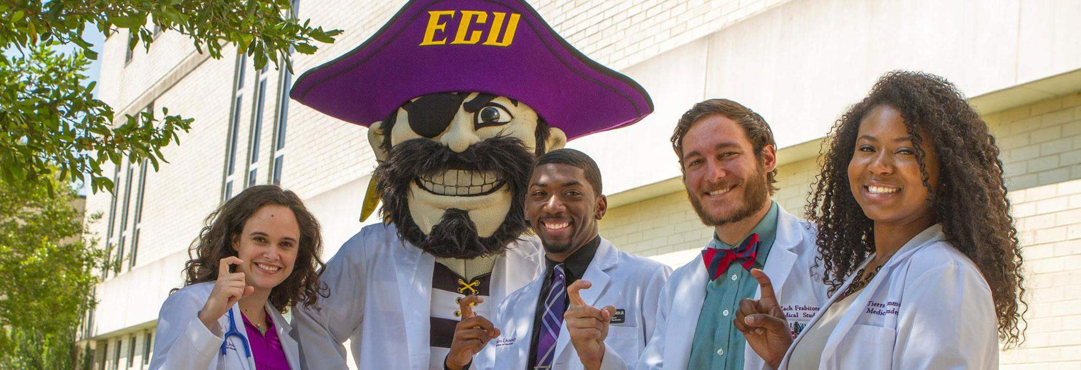
ECU GROW:
Student Staff Training

Slide 2
ECU and Student Affairs Overview
Mission:
Student Affairs provides programs and services that optimize student learning and leadership, builds a safe, supportive and welcoming campus community, fosters the emotional growth and personal development of students, and makes a positive contribution to the overall student experience.
Values: We Are Student Affairs:
Student-centered
Integrity
Excellence
Respect
Belonging
8 Units
22 Departments
12 Offices
311 Employees
40%
60%
250 Full Time
61 Part Time
1,002 Student Employees
Female Male
26,785 Total Enrollment
60% Female | 40% Male | 30% Underrepresented Race/Ethnicity

Slide 3
What is ECU GROW?
Guided Reflection On Work
Help students translate what they have learned from their ECU jobs to their future careers
Set of 5 core competencies

Slide 4
LEADERSHIP COMPETENCIES

Slide 5
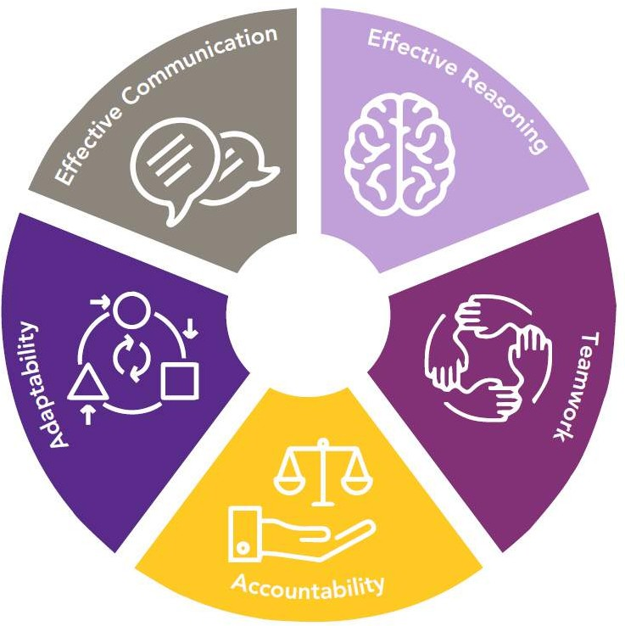
COMPETENCY WHEEL

Slide 6
Effective Communication
Ability to listen effectively and relay information via written, verbal, and non-verbal means in a way that is understood by the target audience.

Slide 7
Effective Communication
Verbal
Written
Non-Verbal
Professional
Timely

Slide 8
Effective Reasoning
Ability to identify challenges and form alternative solutions and approaches to problems using logic while maintaining the integrity of all individuals/organizations.

Slide 9
Effective Reasoning
Information gathering
Value-based decision-making
Problem-solving
Ask what would my supervisor do?

Slide 10
Teamwork
Ability to cooperate and work effectively with others to achieve a common goal or outcome.

Slide 11
Teamwork
Respecting differences
Working together towards shared goals
Pride in your outcomes
Supporting each other

Slide 12
Accountability
Ability to build on personal and ethical foundation while demonstrating integrity, responsibility, and dependability to do assigned tasks with minimal supervision while maintaining a professional level of trust.

Slide 13
Accountability
Who you are when no one is watching
Meeting deadlines
Ownership for mistakes
Showing up

Slide 14
Adaptability
Demonstrating flexibility in the face of changing circumstances and responding proactively to adversity.

Slide 15
Adaptability
Being flexible
Thriving in times of change
Being prepared
Staying calm

Slide 16
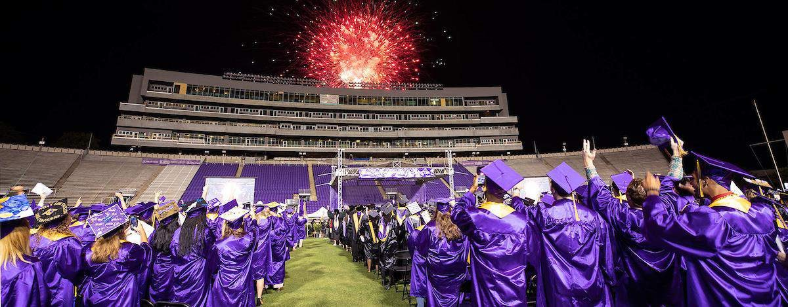
ECU GROW
A leader is one who knows the way, goes the way, and shows the way
– John Maxwell

Slide 17
Questions
More information, handouts, and competency videos can be found online at https://studentaffairs.ecu.edu/grow/

